Slide 1
HOME DESIGN: 5 SECRETS TO GETTING THE HOME YOU WANT
Presented by Nate Moore

Slide 2
TEACHER QUALIFICATIONS
Nathan William Moore
Over 20 years of experience working in the construction industry Currently CEO of Moore Construction Group LLC
Managed over 50 Million Dollars of construction projects in MD/VA/DC
Holds an undergraduate degree in Business Administration and a Masters in Systems in Manufacturing with an MBA.

Slide 3
PURPOSE
The purpose of this course is to provide homeowners, real estate professionals, and those looking to buy their first home with the tools they need to get the home they want. We will teach attendees how to create a vision for their home, solve the issues with their space, personalize the feel of the home, and make it all a reality. We will also cover current design trends including:

Slide 4
PURPOSE
New materials
Trending cabinet styles
Popular colors
Countertop solutions (Granite/Quartz/Concrete etc.)
Home automation
Finally, attendees will learn how to receive accurate and comprehensive estimates, understand costs, and determine if they should renovate or sell and buy something new!

Slide 5
OVERVIEW
Define it!: Identify what you’d like to change about the house
Design it!: Develop a design you’re happy with
Bid it!: Get pricing for your design
Build it!: Engage a construction firm to execute on your design
Buy it!: Determine if it makes better sense to renovate or buy a new house and start fresh

Slide 6
WHAT CAN DESIGN OFFER YOU?
Create opportunity for more inventory that meets buyer needs (Agents)
Get the home you want without moving
Remediate structural issues
Reconfigure a room, a floor, or your entire home
Create a vision for a house before you sell
Make a house reach its full potential by designing it to the highest and best use

Slide 7
DESIGN LEVELS
Schematic Design
Design Development
Finish Selections
Permitting
Construction Documents

Slide 8
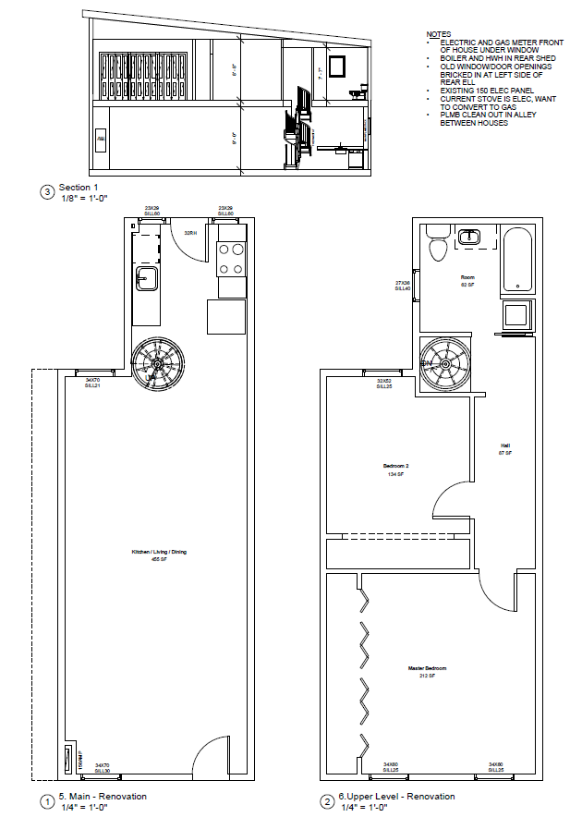
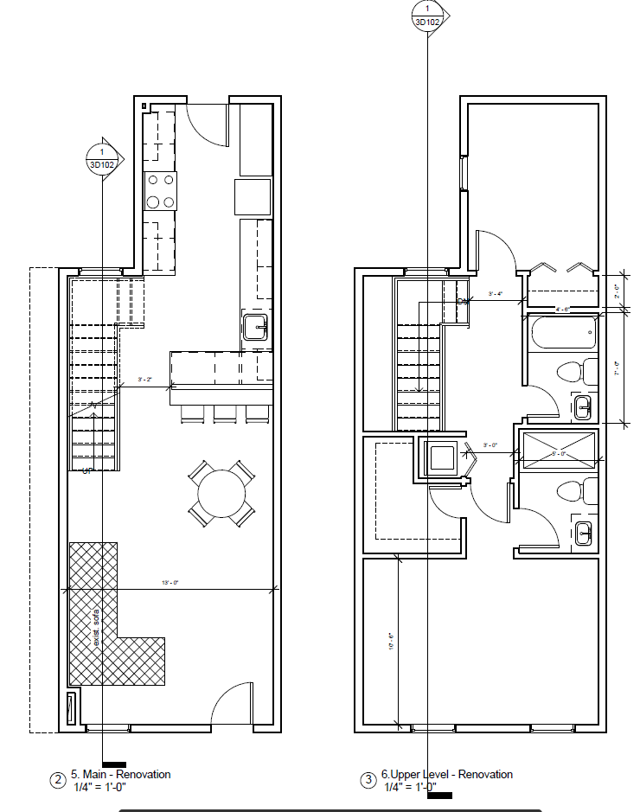
Schematic Design

Slide 9
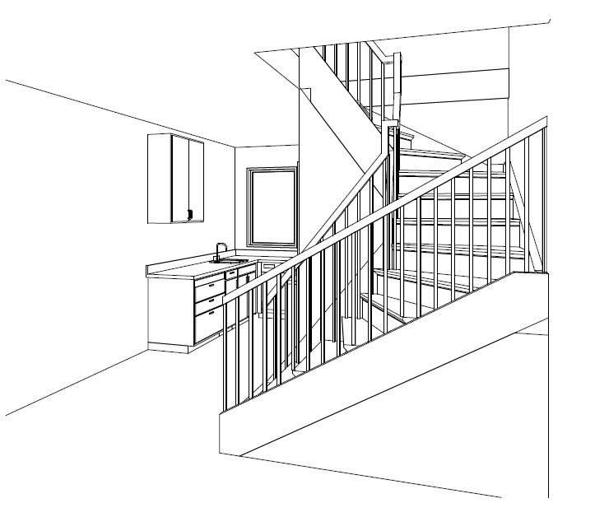
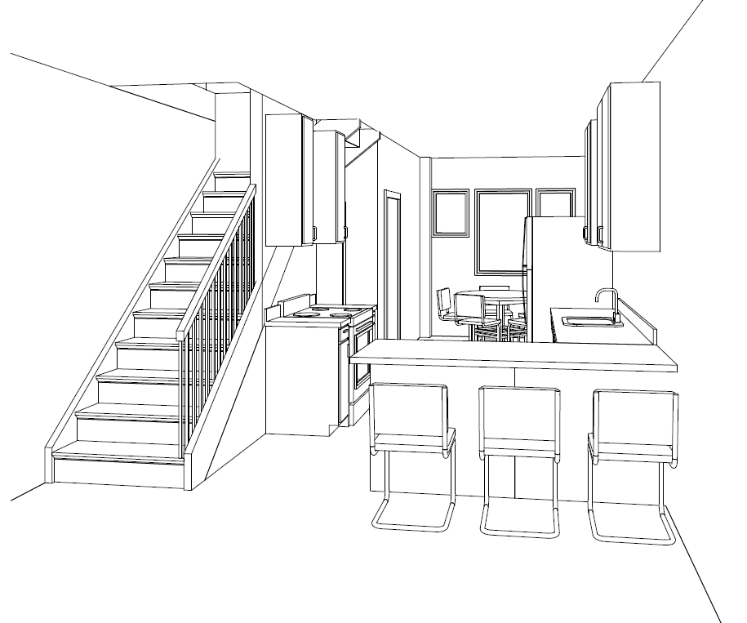
Schematic Design

Slide 10
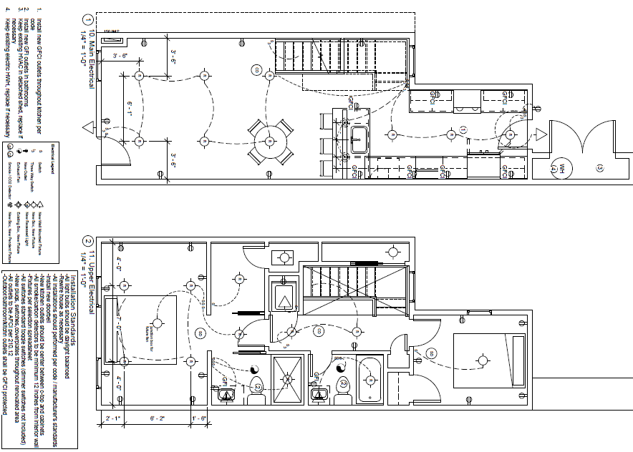
Design Development

Slide 11
Finish Selections

Slide 12
SOLVING YOUR SPACE
Re-configure problem areas
Adding a bathroom
Adding a bedroom/Master suite
Re-configure a kitchen
Building an addition
Digging out/Finishing a basement
Permitting requirements
Zoning
Drawings
Architectural/Engineering stamps
Historical considerations
HOA

Slide 13
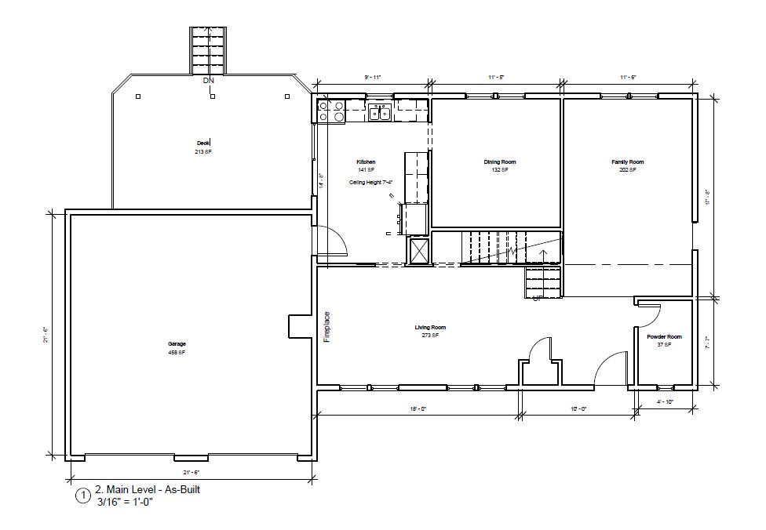
Case Study: Larger Kitchen

Slide 14
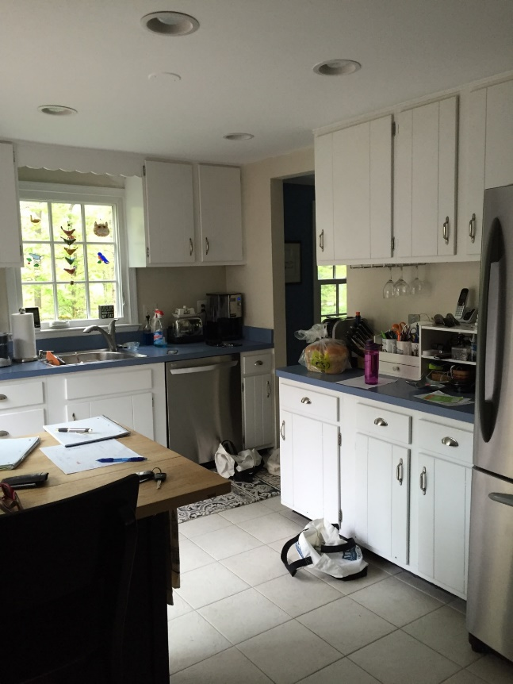
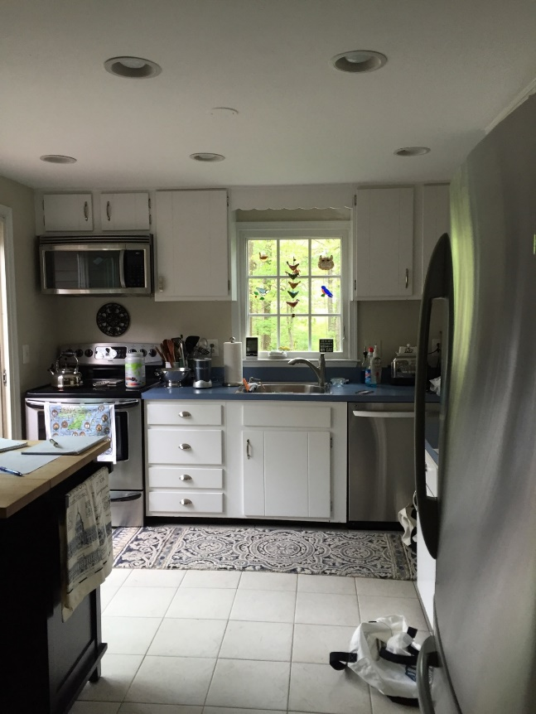
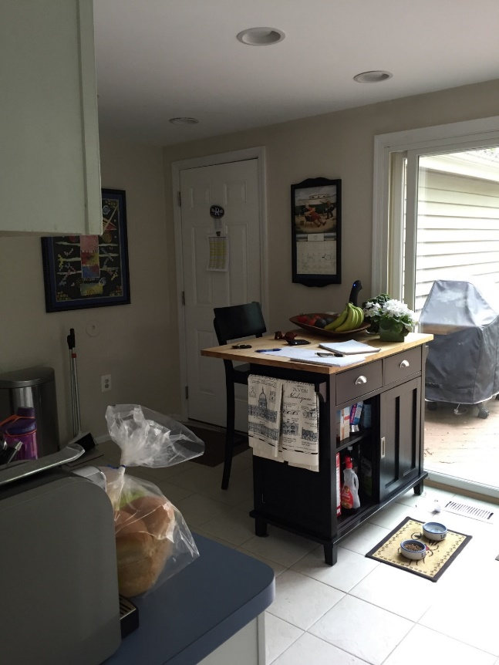
Case Study: Larger Kitchen

Slide 15
Case Study: Larger Kitchen
Family of 5 was living in a 4 bedroom, 3 bath, 2,000SF plus finished basement colonial style home built in 1979.
Loved the home and had adequate living space and bedrooms for their whole family.
Small kitchen that was cut off from the rest of the home left a lot to be desired and caused the family to order in dinner often.
Renovation doubled square footage of kitchen / created a more open concept between the dining room and kitchen where the whole family could gather

Slide 16
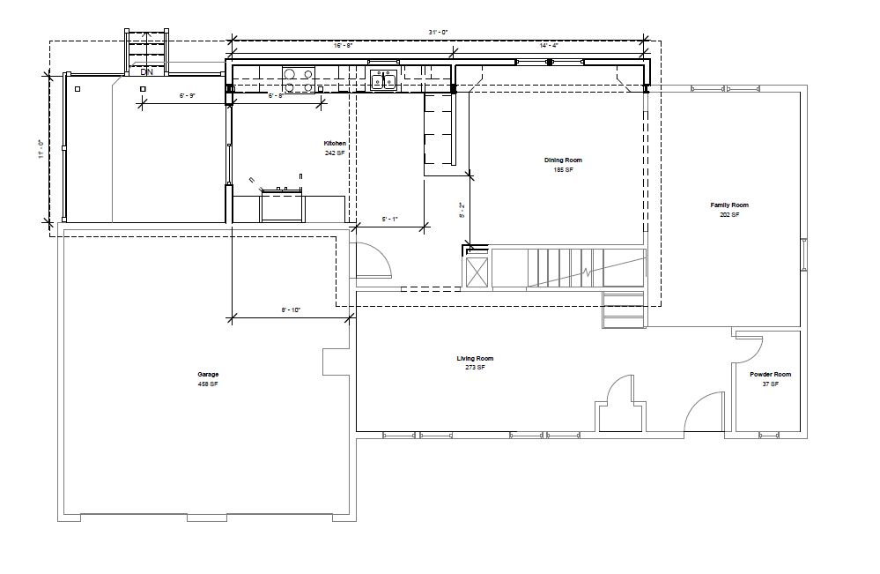
Case Study: Larger Kitchen

Slide 17
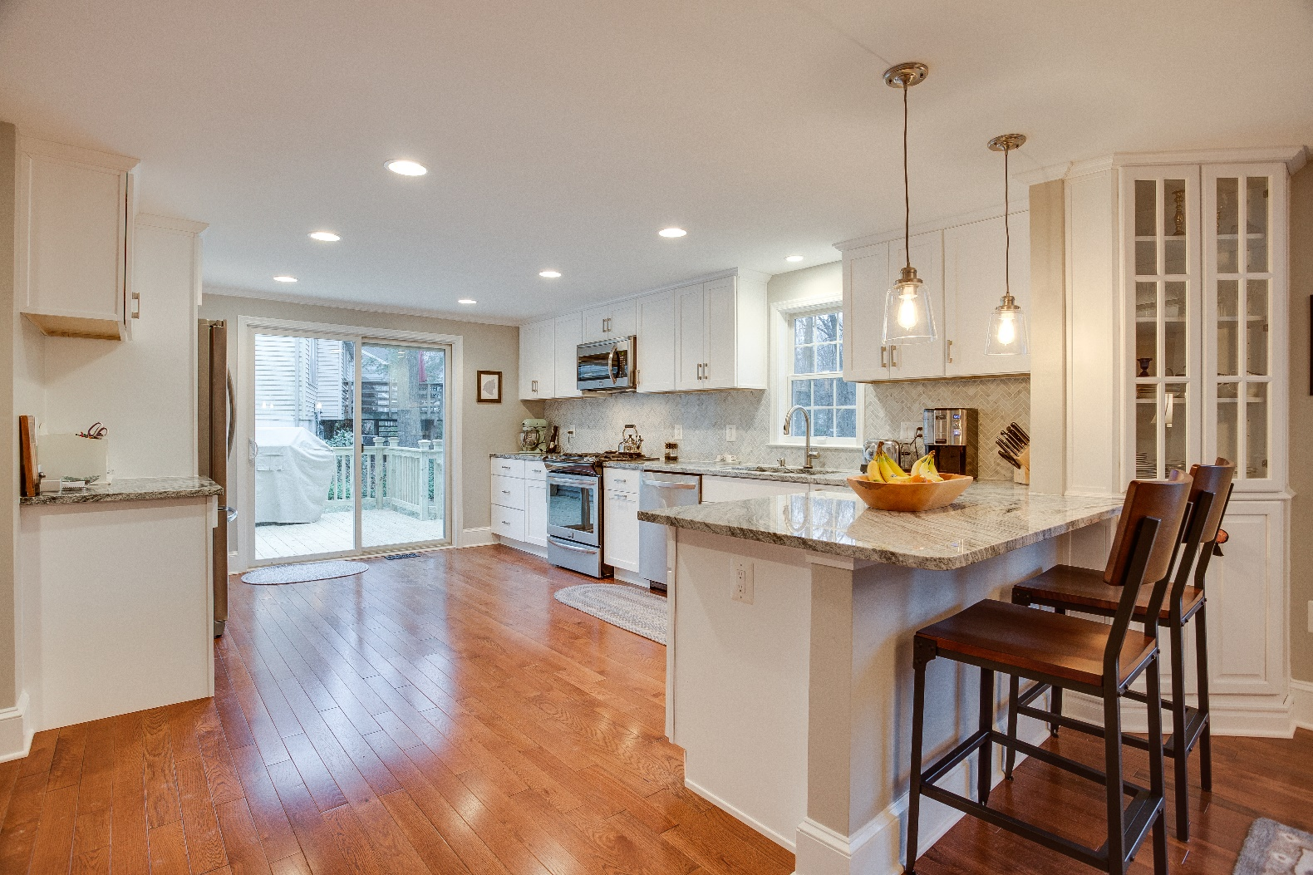
Case Study: Larger Kitchen

Slide 18
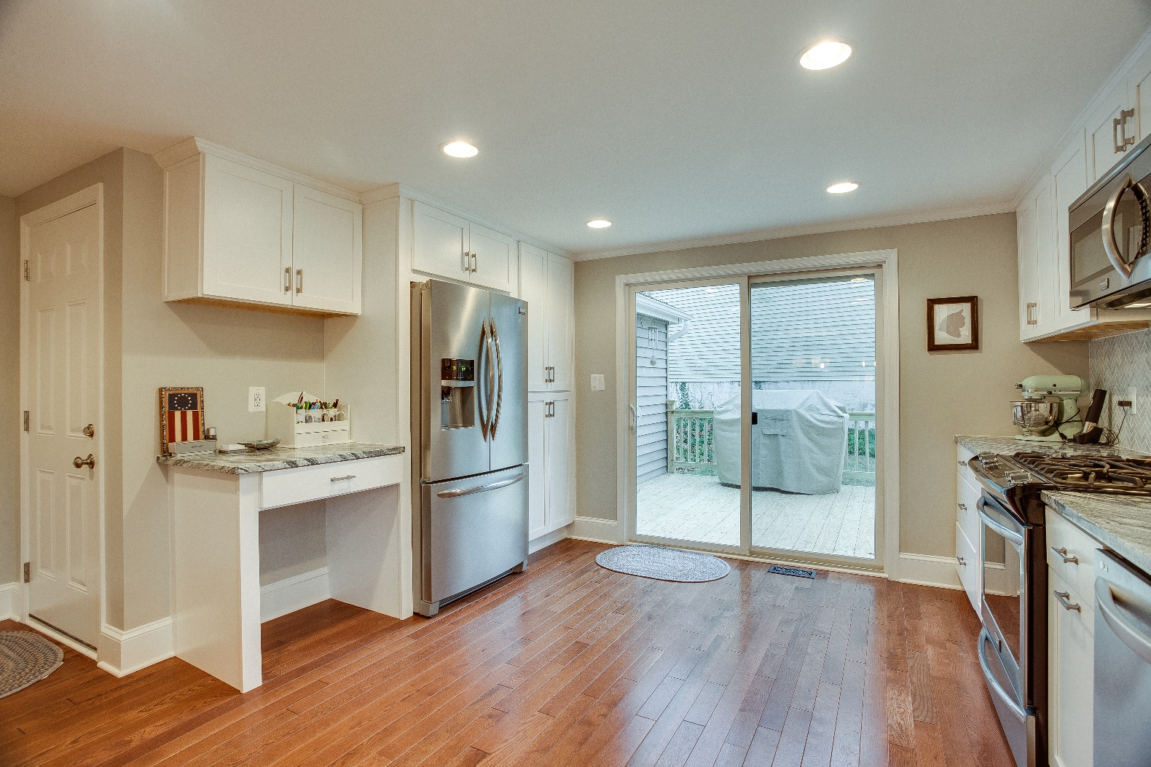
Case Study: Larger Kitchen

Slide 19
PERSONALIZING YOUR SPACE
Create a theme for your space
Define your finish selections
Cabinets
Countertops
Tile
Flooring
Doors/trim/windows
Paint

Slide 20
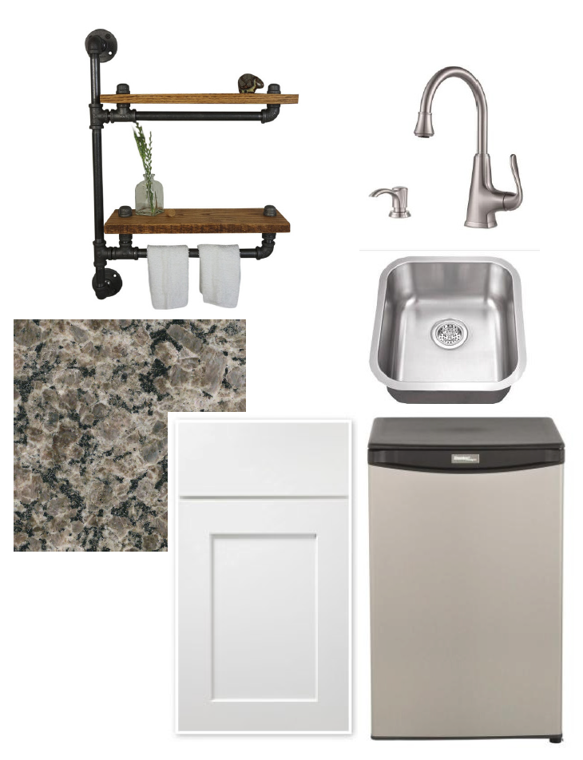
Story Boards
Basement Wet Bar

Slide 21
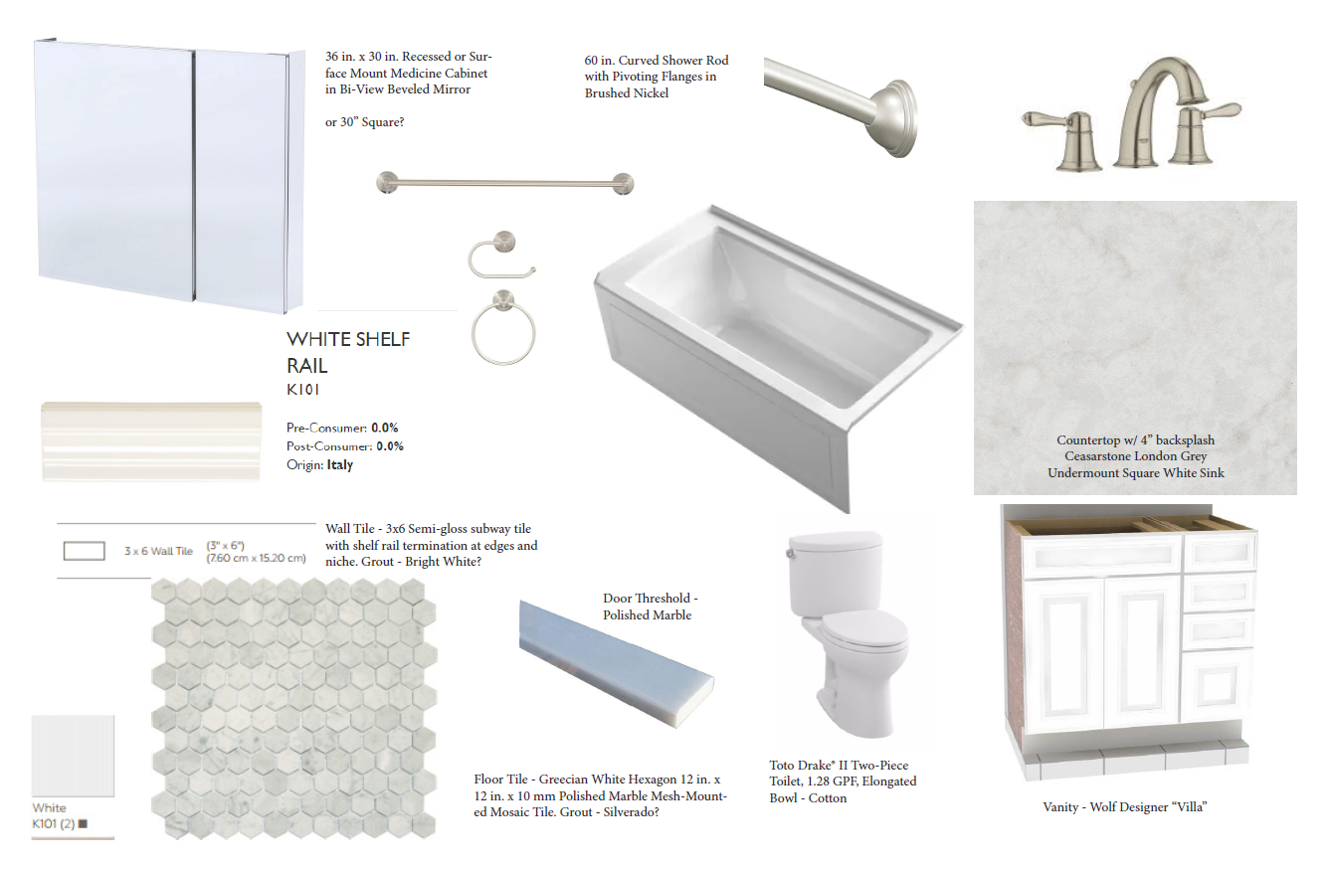
Story Boards
Master Bath

Slide 22
CURRENT DESIGN TRENDS
Popular colors
Cabinet styles
Countertops (Granite/Quartz/Concrete etc.)
Home automation / Technology

Slide 23
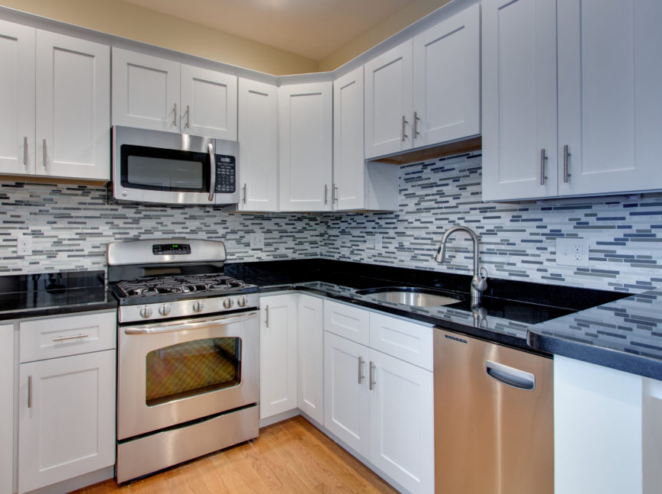
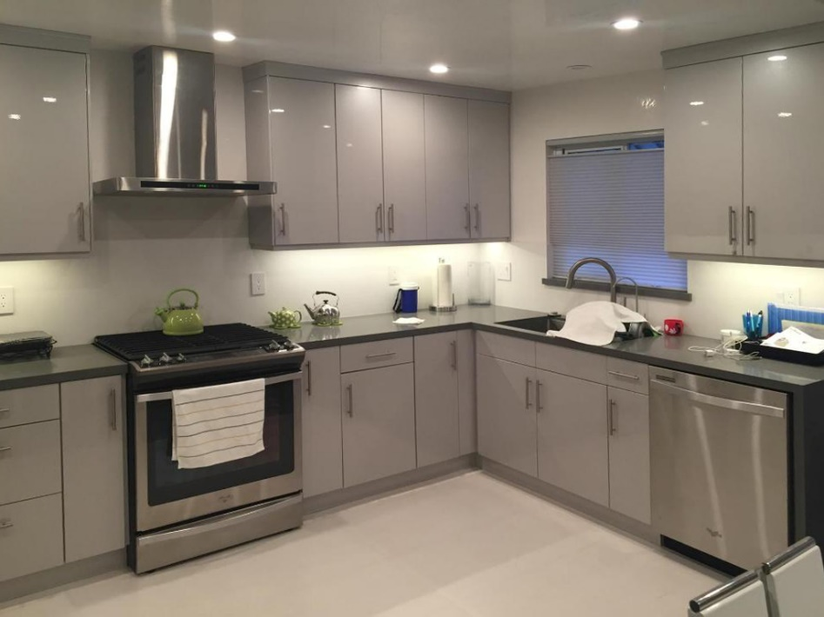
Popular Cabinet Styles
Shaker – five-piece door with recessed center panel Versatile, simple clean lines, well balanced, timeless,
European – Frameless, seamless façade, clean, slightly more storage

Slide 24
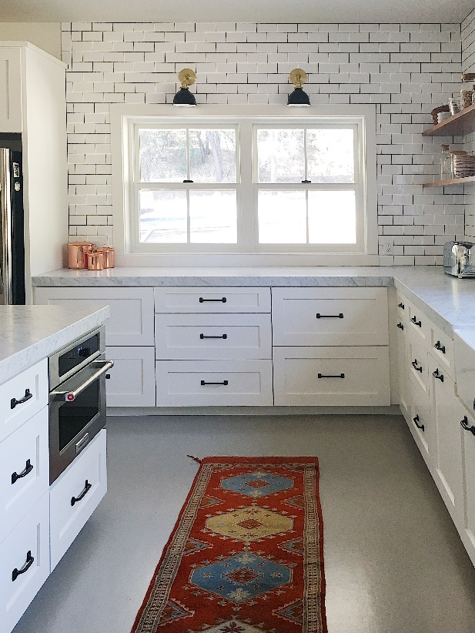
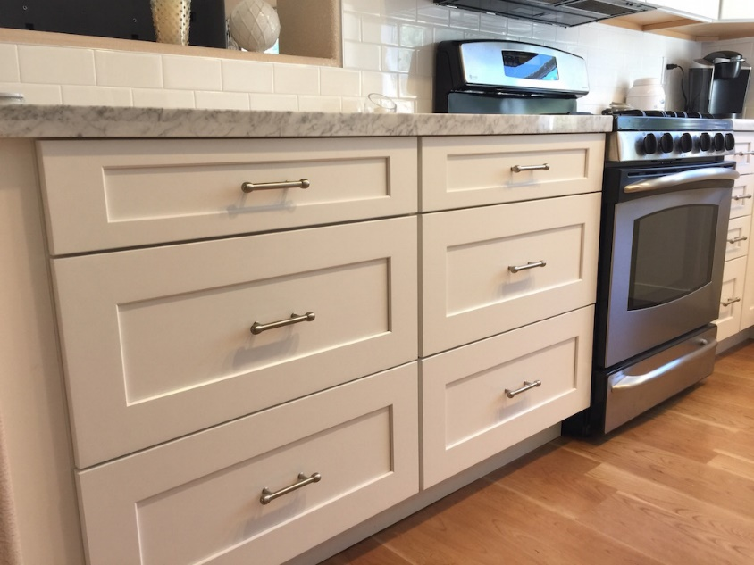
Popular Cabinet Styles
Drawers– four, three, or two drawers options
Versatility, Ease of Access, Efficiency, Clean Lines
Compliments open shelves at upper walls

Slide 25
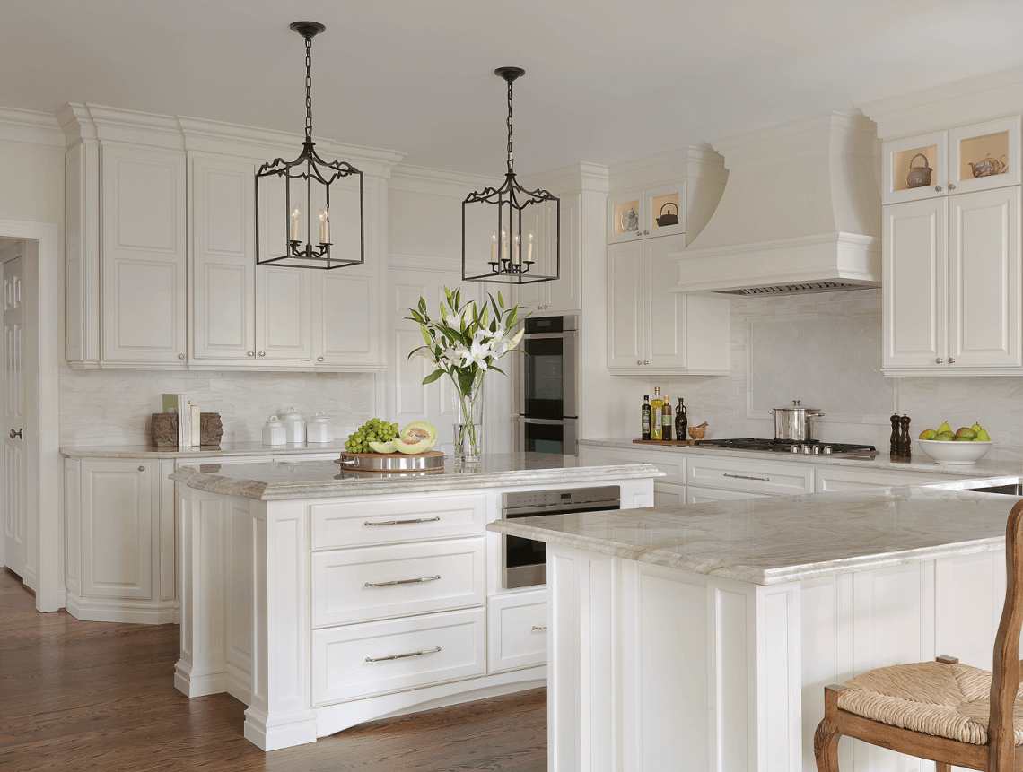
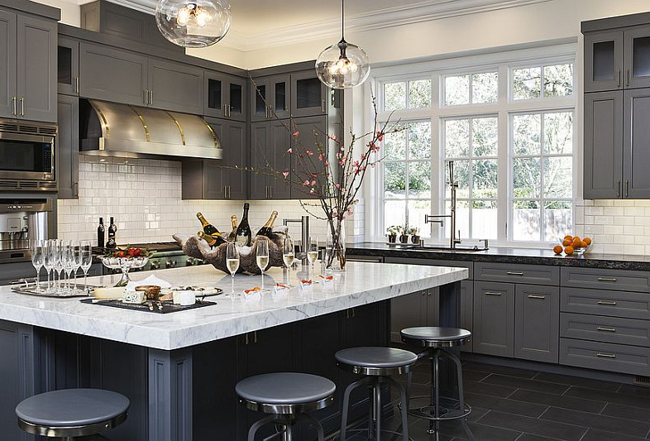
Popular Cabinet Styles
Colors – White & Gray
White cabinets continue to be the most popular in the past decade, but gray is quickly catching up, manufacturers think 2018 might be the year Gray tops out
White cabinets compliment a wide range of countertop choices

Slide 26
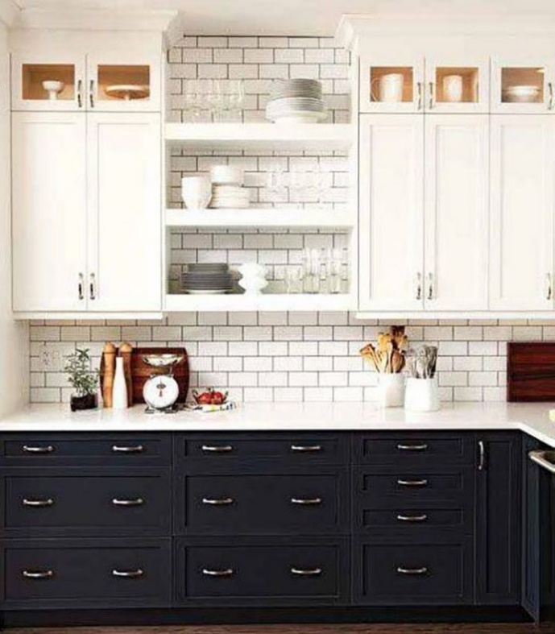
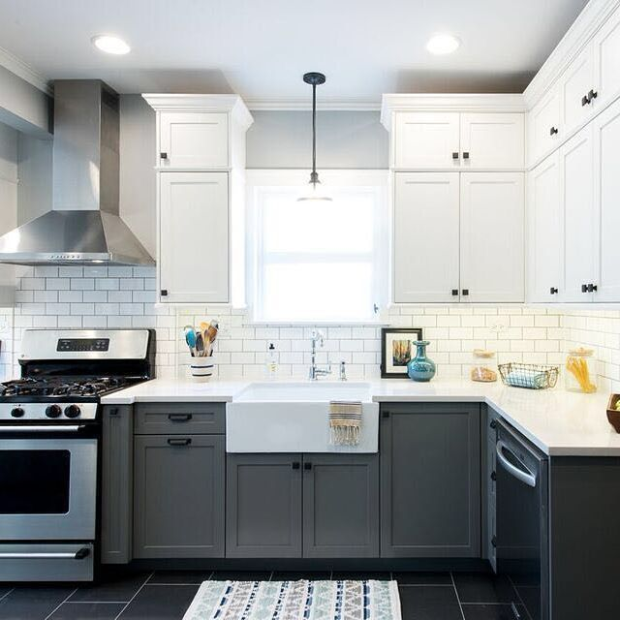
Popular Cabinet Styles
Two-Tone
White cabinets continue to be the most popular in the past decade, but gray is quickly catching up, manufacturers think 2018 might be the year Gray tops out
White cabinets compliment a wide range of countertop choices

Slide 27
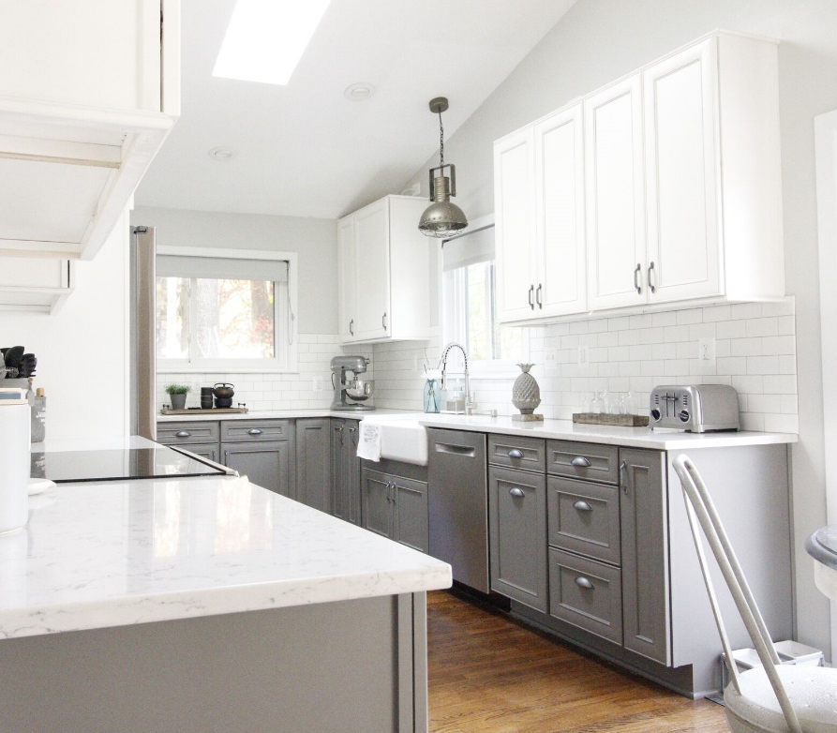
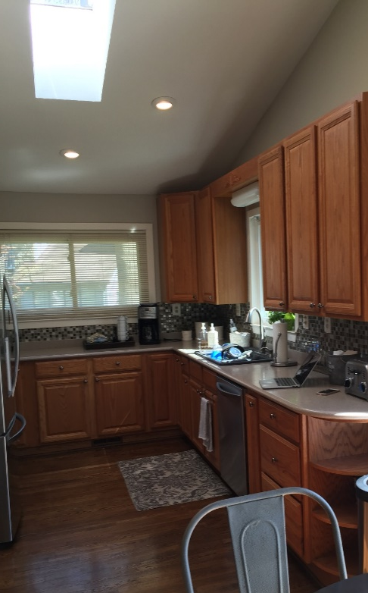
Popular Cabinet Styles
Two-Tone
BEFORE AFTER

Slide 28
Countertops
Granite, Quartz, Concrete, Butcher Block
Granite 100% natural, a lot of variation from slab to slab since they’re cut directly from the earth, sealant recommended to maintain vibrant finish, no two pieces look the same
Quartz 97% natural, more consistent veining, imperfections removed, polymer resins resist staining, no sealing necessary, most durable low maintenance option, wide range of colors and patterns
Concrete customizable, more expensive, heat and scratch resistant, porous nature requires frequent sealing and even then imperfections are difficult to avoid, color can vary throughout due to natural aggregates
Butcher Block affordable, suitable for smaller areas (islands, bars, etc), high maintenance, oil often, don’t seal, larger areas the seams are very visble

Slide 29
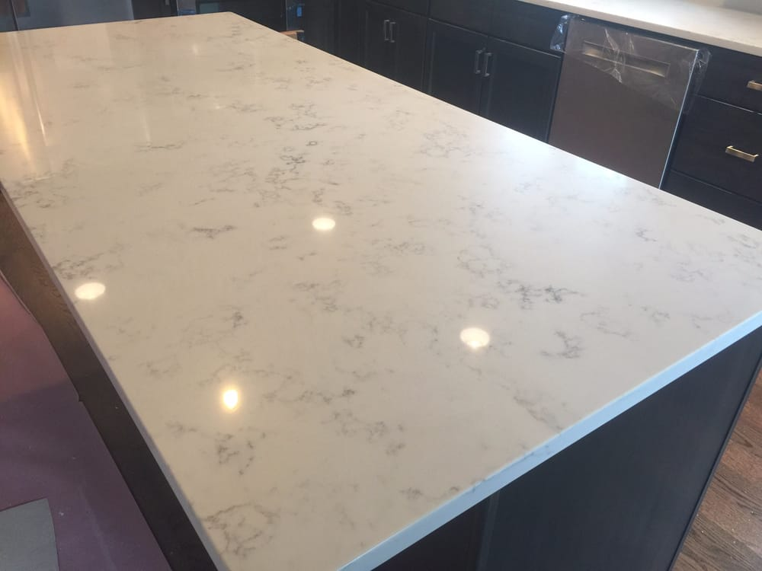
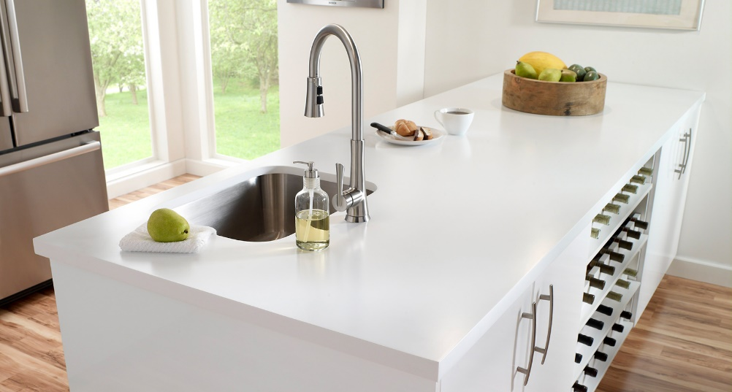
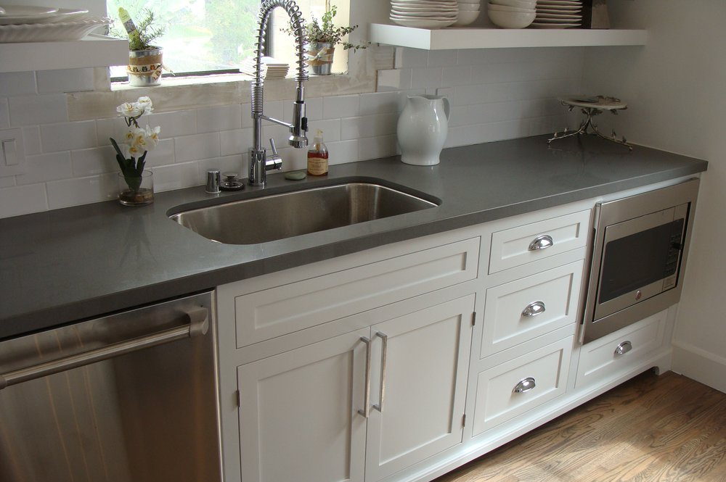
Quartz Trends
Marble Appearance
Solid White
Concrete Appearance
Dramatic Veining

Slide 30
Technology

Slide 31
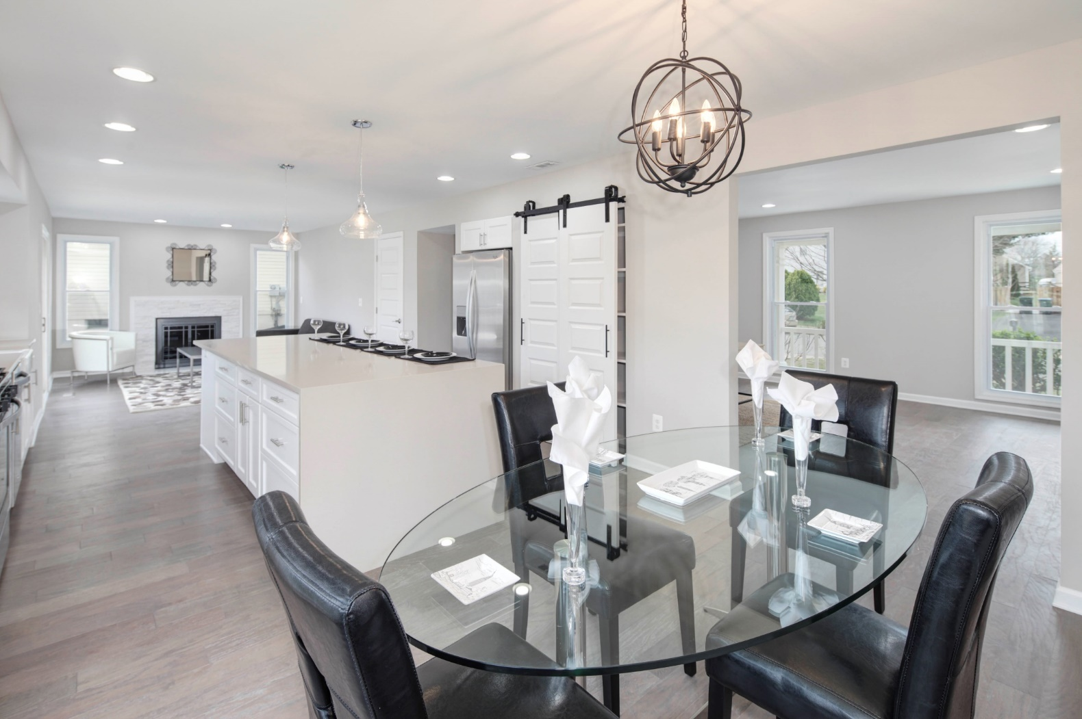
General Trends
Waterfall Edge Countertops / Barn Doors

Slide 32
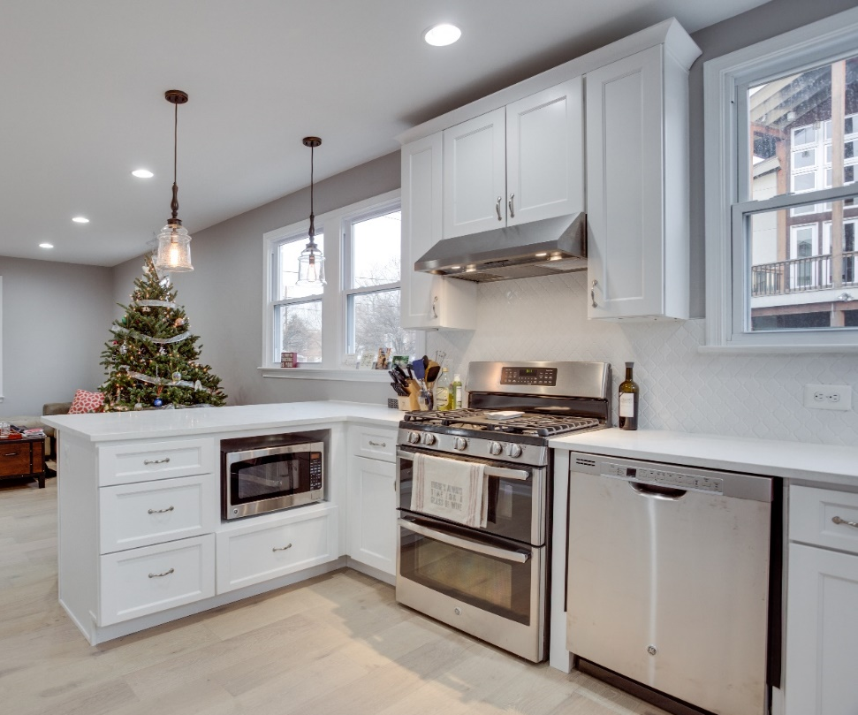
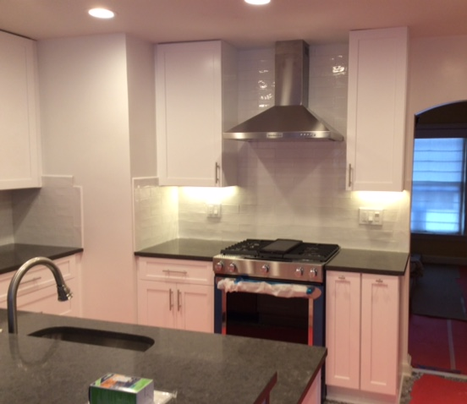
General Trends
Range Hoods / Base Cabinet Microwaves

Slide 33
General Trends
Farm Sinks

Slide 34
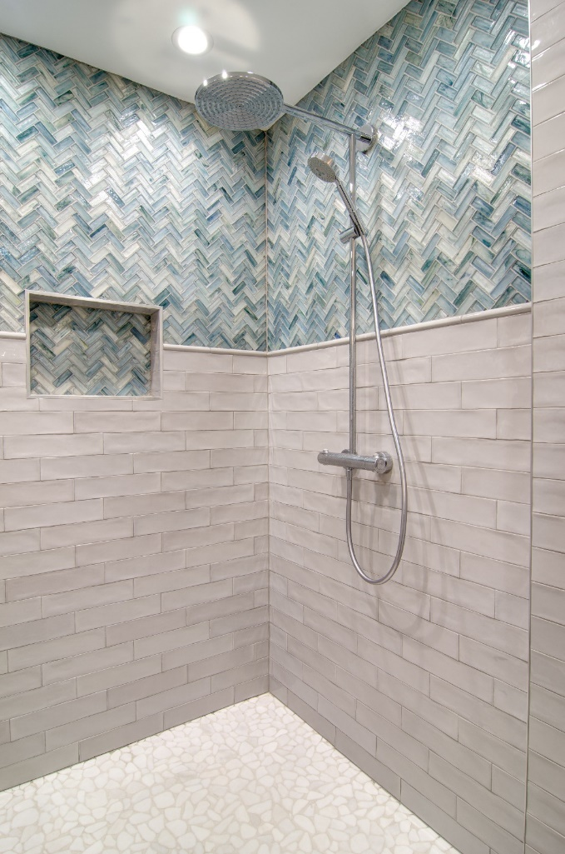
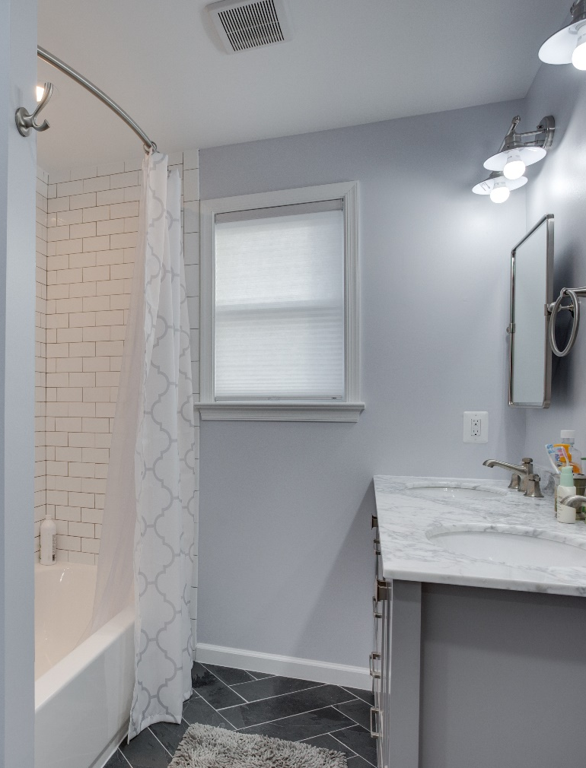
General Trends
Herringbone Tile

Slide 35
ESTIMATING COSTS
Design Costs
Schematic design
Full plan sets
Finish selections (interior design)
Construction costs
Cost ranges at schematic design phase
Hard bids after completion of full plan sets

Slide 36
BUILD IT OR BUY IT
Review design and costs, evaluate if the price is supported by the neighborhood (confer with Realtor)
Use design to help sell the house as an option to buyers
List it, or build it!

Slide 37
SUMMARY
Contractor basics
Types of contractors
Levels of contractors
Contractor qualification
Permits
When are permits required
How to check if work was permitted
What unpermitted work means to your clients
Estimating construction costs
Determining remodeling ROI (return on investment)

